Slide 1
Long Island: Climate Change
Adrienne Esposito,
Executive Director

Slide 2
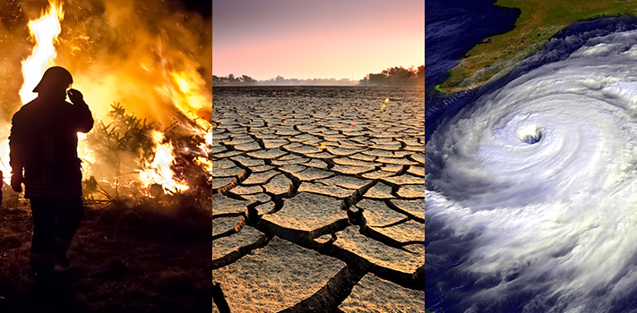
United Nations Report 2023
“Human Activities through emissions of greenhouse gases have unequivocally caused global warming.”
“Human caused climate change is already affecting many weather and climate extremes in every region across the globe.”

Slide 3
Climate Change: Where are we now?
Rising temperatures
In the last 50 years, we have experienced a 2°F rise in global temperatures.
The EPA estimates we will see a 4.5°F to 10°F increase by the 2080s.

Slide 5
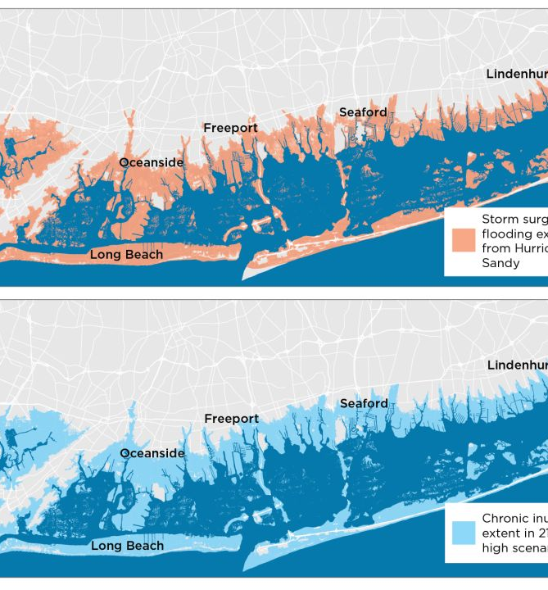
Sea Level Rise: New York
The sea level has risen significantly more on New York's coast since 1880 (about 13 inches) than it has globally (8 inches), according to NOAA's climate summary for the Empire State.
NOAA predicts that in a worst-case scenario, we could see the average high tide in NYC being 2 feet higher than the storm surge during Superstorm Sandy. Under this worst case scenario, we would see flooding across the south shore, with the barrier islands and most homes south of Merrick Road either flooded or underwater.

Slide 6
Warming waters
DEC says ocean and coastal temperatures along the northeastern U.S. have increased by 0.06°F per year from 1982 to 2016 and are projected to continue to warm faster than most marine waters around the world.
Long Island Sound is warming four times faster than the global ocean, according to a UConn study based on four decades of data. Summer water temperatures in Long Island Sound rose by 5 degrees between 2003 and 2020, a rate Dr. Gobler from Stony Brook University said “far exceeds” global averages.

Slide 7
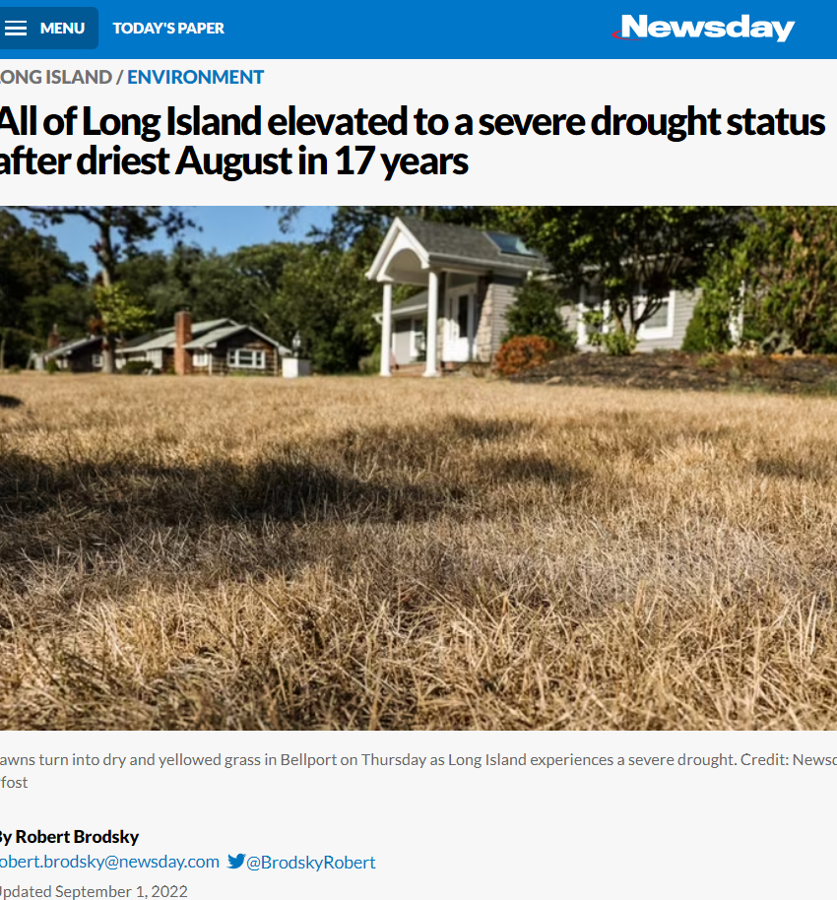
More Frequent Droughts
Both Nassau and Suffolk counties experienced a warming trend of 3.3 degrees per 100 years over the time period of 1895-2018 according to NOAA.
U.S. Global Change Research Program (USGCRP)’s National Climate Assessment found that in the northeast region, the frost-free season, or growing season, was 10 days longer in the region over the 1986-2015 period compared to 1901-1960. Winters are getting milder and spring is coming earlier. This opens the door for invasive species, mosquitoes, drought, increased water demand etc. In our region, winters are warming 3x faster than summers.

Slide 8
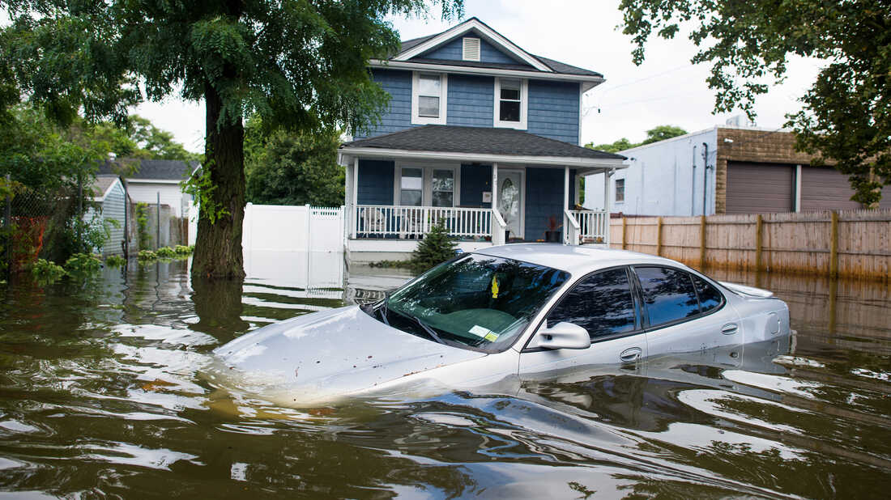
Extreme Weather
From 2010-2020: NY experienced 31 extreme weather events, costing the state $100 billion in damages.

Slide 9
Long Island Current Power
Three legacy fossil fuel power plants (Northport, Port Jefferson, and Island Park) provide 40% generation capacity for electricity.

Slide 10
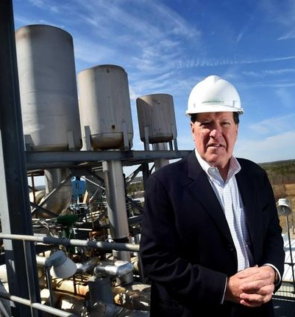
Caithness Power Plant
We also generate power from a combined cycle power plant in Yaphank (Caithness) and 30+ additional fossil fuel “peaker plants”.

Slide 11
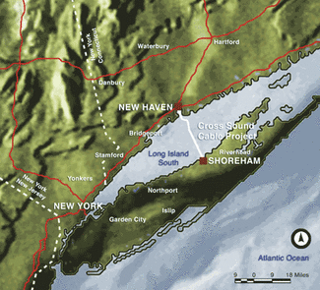
Cross Sound Cable
Cross-Sound Cable Company, LLC is a high voltage electrical transmission company providing 330MW’s of electrical transmission capacity to customers via the Cross-Sound Cable. It is a 24 mile (39km) long submarine cable buried in Long Island Sound that connects the electric transmission grids of New England and Long Island, NY.

Slide 12
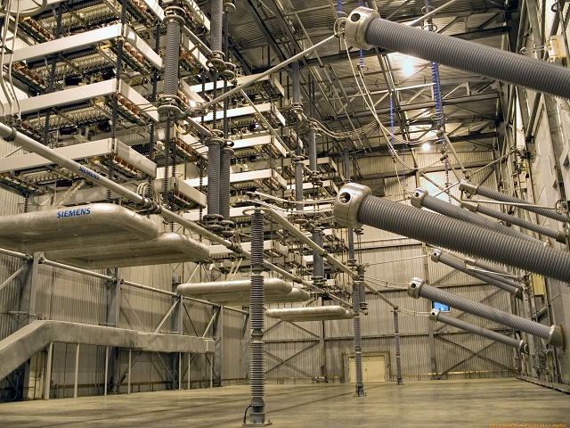
Neptune Cable
Since starting operation in mid-2007, Neptune has provided, on average, approximately 20 percent of the electric power used on Long Island, and runs at its full capacity of 660 MW most of the time. In addition, Neptune has performed as well or better than expectations, averaging 98 percent availability.
LONG ISLAND HOMES POWERED BY NEPTUNE Regional Transmission System
600,000
HOMES

Slide 13
If we are going to fight climate change here on Long Island, we need to transition away from fossil fuels and embrace renewable energy, particularly offshore wind and solar.

Slide 14
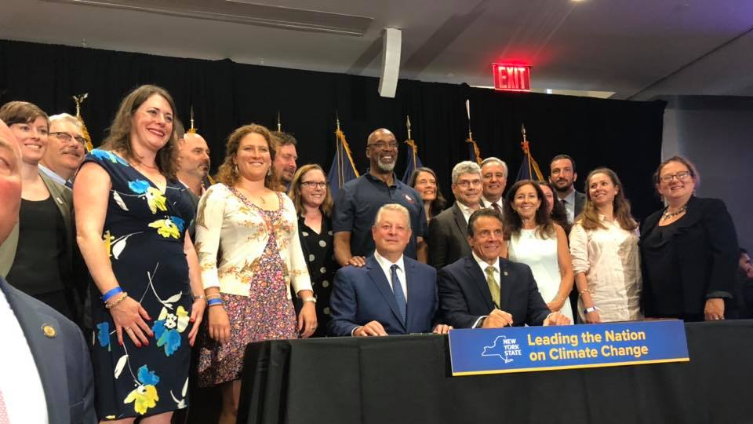
NEW YORK STATE LEADERSHIP
New York’s Climate Leadership and Community Protection Act – Most Ambitious Climate Change law in the country, signed in 2019.
70% renewable energy by 2030.
Carbon free electricity by 2040.
85% reduction in greenhouse gas emissions, 15% carbon offsets. Powerplants cannot offset emissions.
Net-zero carbon economy by 2050.
9,000mw of offshore wind by 2035
and 6,000 mw solar by 2025.
40% state investments to frontline/
disadvantaged communities.
Guaranteed labor protections.

Slide 15
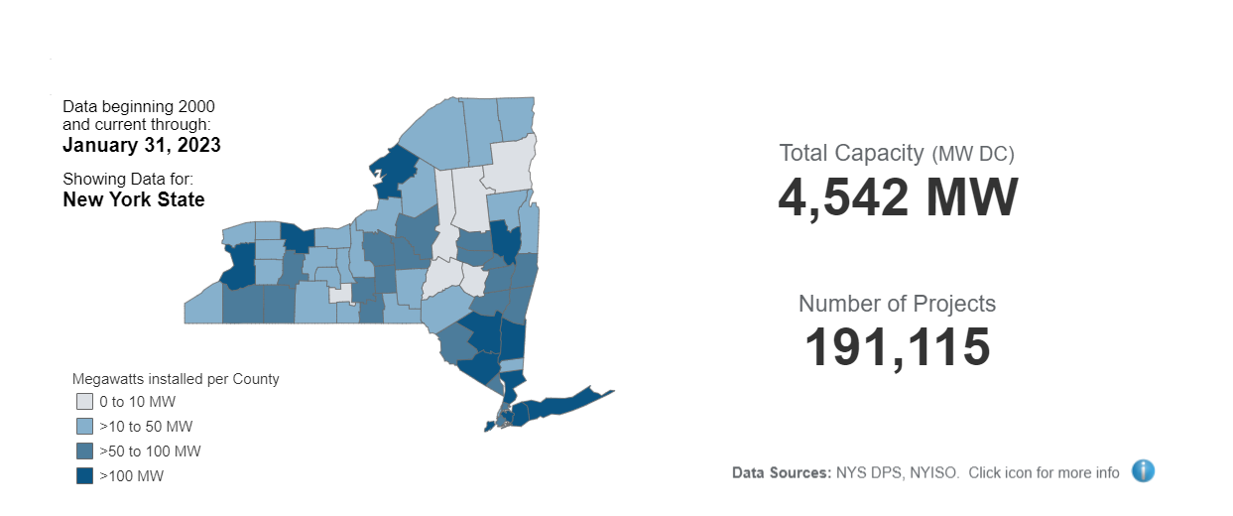
Solar Energy in New York
New York continues to be a national leader in the clean energy transition with the most aggressive climate change program in the nation putting the State on the path to be entirely carbon-neutral across all sectors of the economy. New York State's Climate Leadership and Community Protection Act (CLCPA) calls for 70 percent of the State's electricity to come from renewable sources by 2030 and 6,000 megawatts of solar by 2025. NY-Sun, New York’s solar initiative advances the scale-up of solar and is moving the State to a more sustainable, self-sufficient solar industry.

Slide 16
Large Scale Solar Projects: Parking Lots

Slide 17
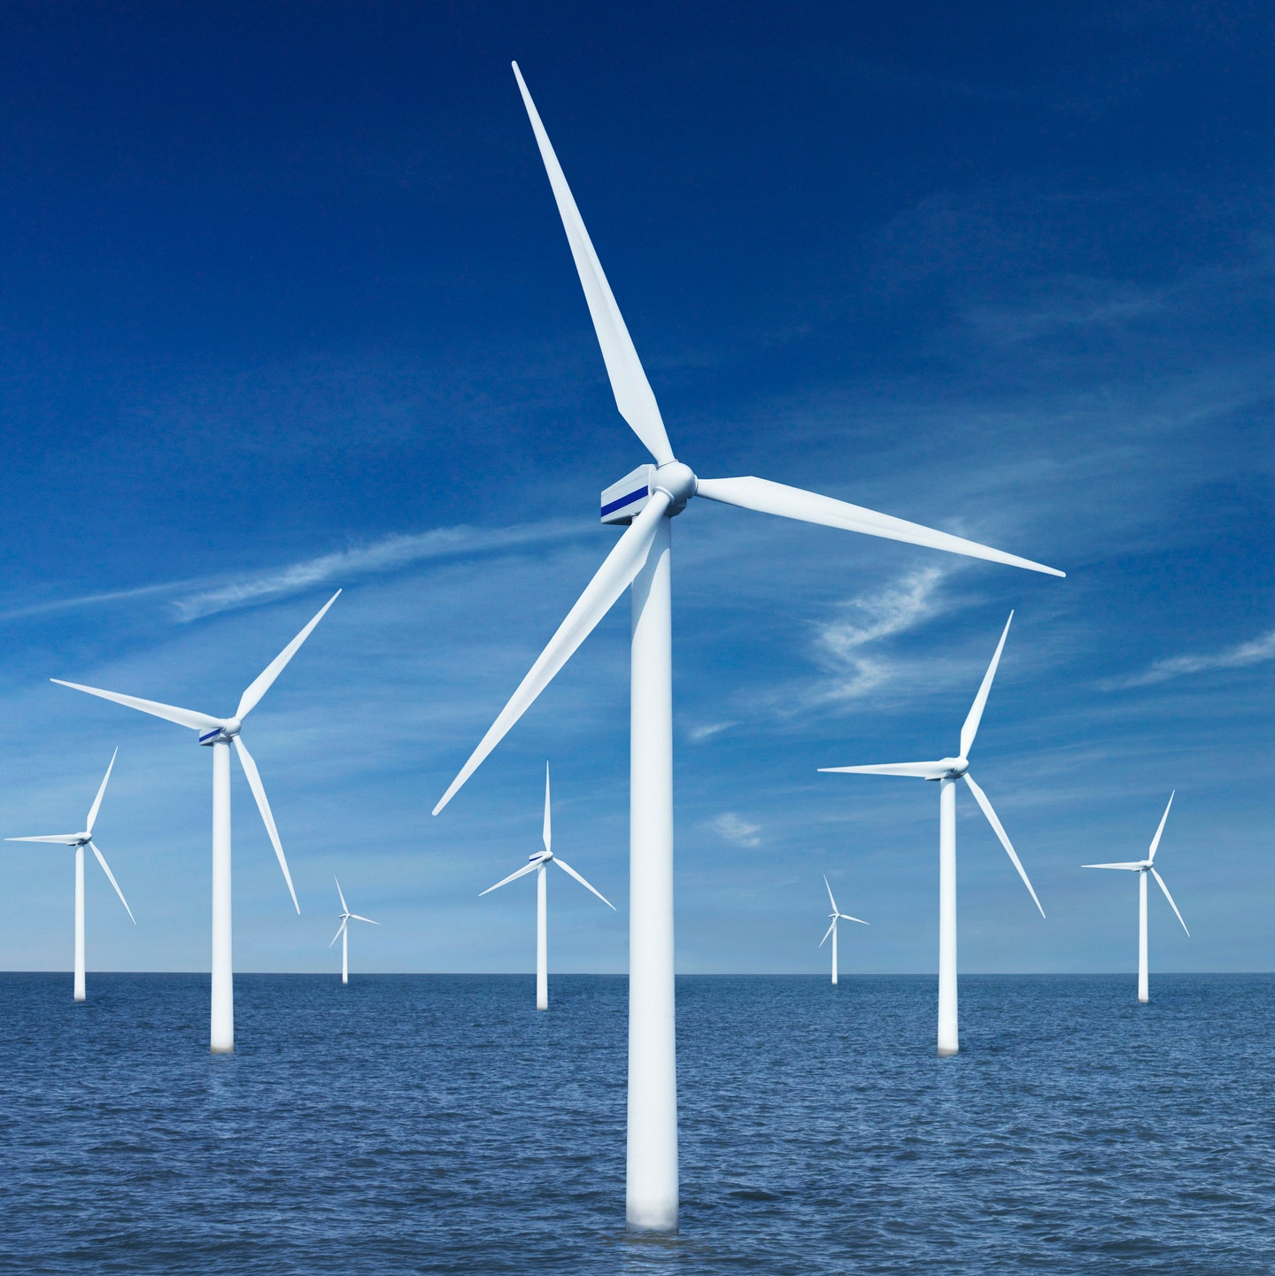
Wind Energy
Wind is used to produce electricity by converting the kinetic energy of air in motion into electricity. In modern wind turbines, wind rotates the rotor blades, which convert kinetic energy into rotational energy. This rotational energy is transferred by a shaft which to the generator, thereby producing electrical energy.

Slide 18
Offshore Wind Power is not new
First offshore wind farm: Denmark
Vindeby Offshore Wind Farm was the first offshore wind farm in the world, erected in 1991 off the coast of the town of Vindeby on the Danish island of Lolland. It was decommissioned for cost reasons in 2017 after 25 years of useful life.

Slide 19
28,000
Megawatts

Slide 20
27,000
Megawatts

Slide 21
WHAT ABOUT USA?

Slide 23
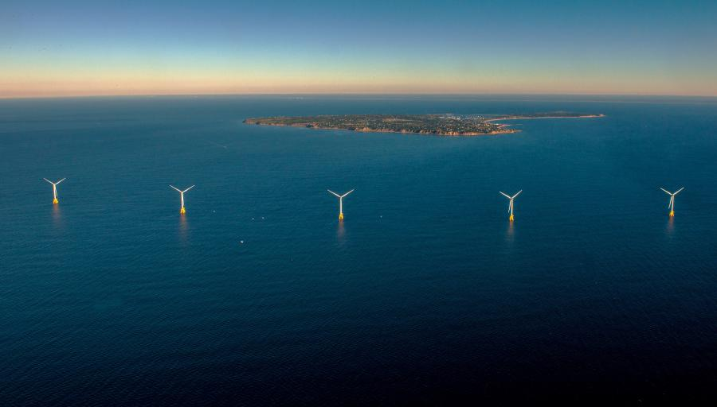

Slide 24
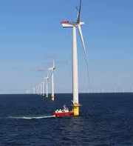
OFFSHORE WIND BENEFITS
9,000 mw will power 6 million homes and provide 30% of NY’s electricity, with power generated off the coasts of LI and NYC.
Offshore wind farms will create 10,000 local jobs in manufacturing, installation, and operations.
Each project will be required to undergo an in-depth environmental review process, including opportunities for public comment.

Slide 26
Project | Capacity | Location | Review Process | Completion
South Fork Wind Farm | 130 mw 70,000 homes | 35 miles off Montauk, connects to East Hampton | Approved by BOEM, under construction | Expected to be operational the end of 2023
Empire Wind 1 | 800+ mw 500,000 homes | 20 miles off the Rockaways, connects to South Brooklyn Marine Terminal | Federal review launched in 2021 | Expected to be operational by 2026
Empire Wind 2 | 1,260 mw 600,000+ homes | Off the south shore of LI, connects to Island Park | Federal review launched in 2021 | Expected to be operational by 2026
Sunrise Wind | 880 mw 500,000 homes | 30 miles off Montauk, connects to Holbrook | Federal review launched in 2021 | Expected to be operational by 2025
Beacon Wind | 1,230 mw 600,000+ homes | 50 miles off Montauk, connects to Astoria via cable under LI Sound |  | Expected to be operational by 2028

Slide 27
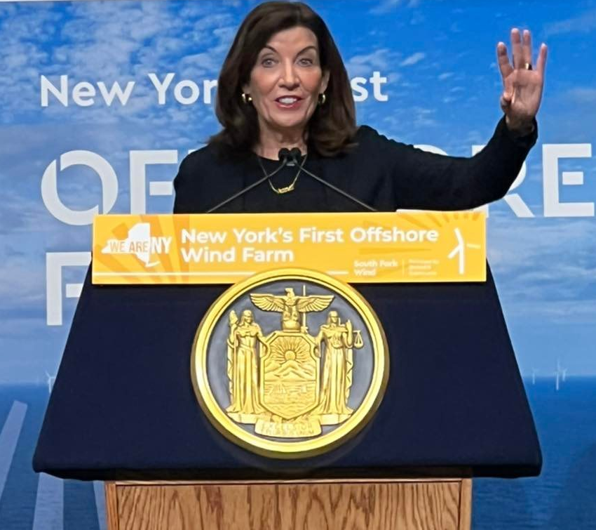
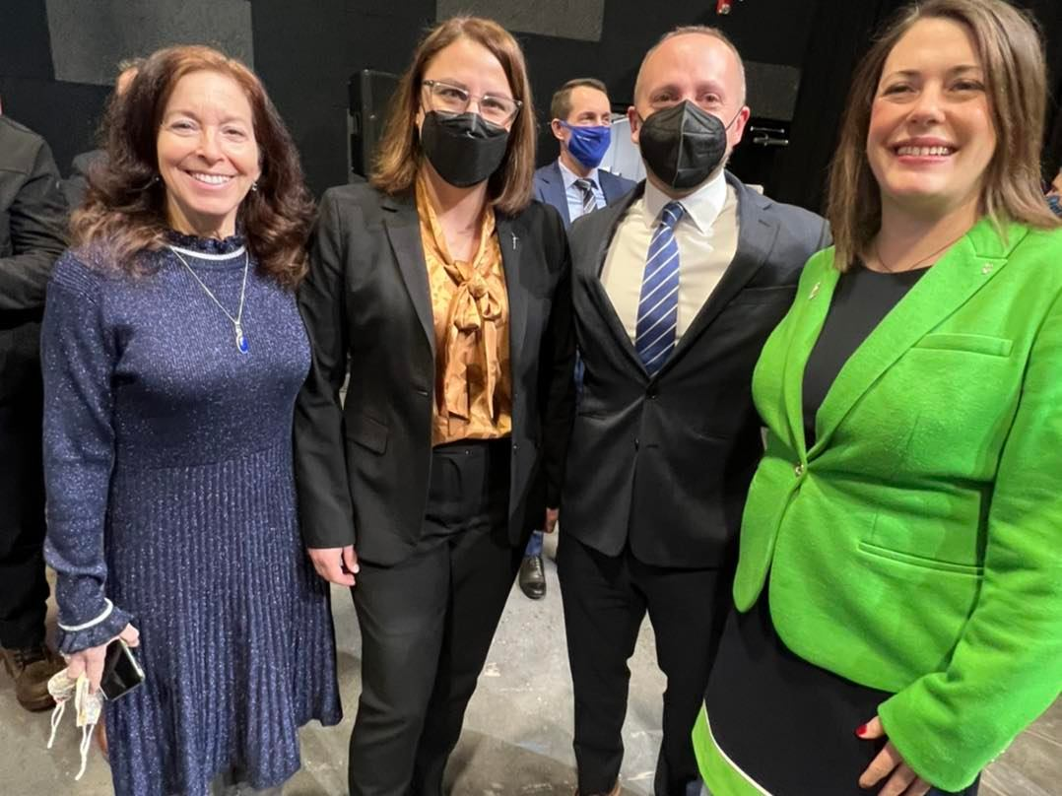
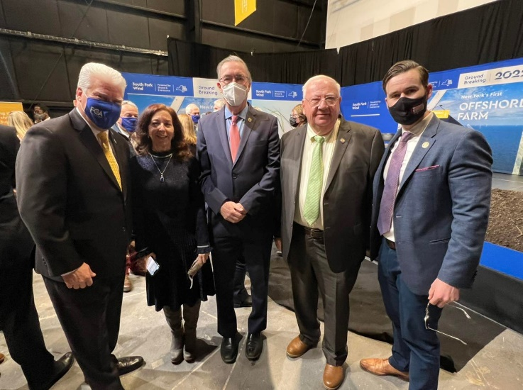
NY’s First Offshore Wind Farm
South Fork Wind broke ground in February 2022 and is currently under construction.
They will install 12 turbines 30+ miles off Montauk and build a cable connection from the turbines to a substation in East Hampton via Wainscott beach.

Slide 28
Offshore Wind--Benefits
New York City
The South Brooklyn Marine Terminal in Sunset Park will be a major offshore wind hub.
Will house the largest offshore wind port in the nation.
The SBMT, which will specialize in assembly, operations and maintenance of the turbines, and is projected to create over 1,000 jobs based in the waterfront environmental justice community.
Long Island
New York’s first offshore wind operations and maintenance facility is being developed in East Setauket.
Port Jefferson will have the nation’s first service operations vessel.
Education and workforce development programs: Suffolk County Community College will be home to a $10 million National Offshore Wind Training Center.
SUNY Farmingdale and Stony Brook University will also work in partnership to create an Offshore Wind Training Institute to train and certify 2,500 workers

Slide 29
Long Island Benefits for Job Growth

Slide 30
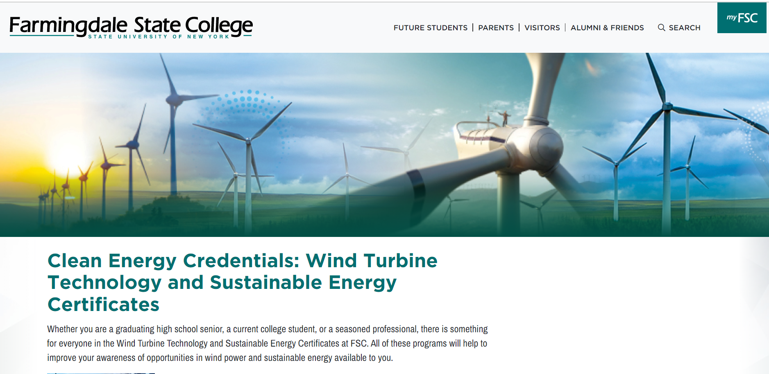

Slide 31
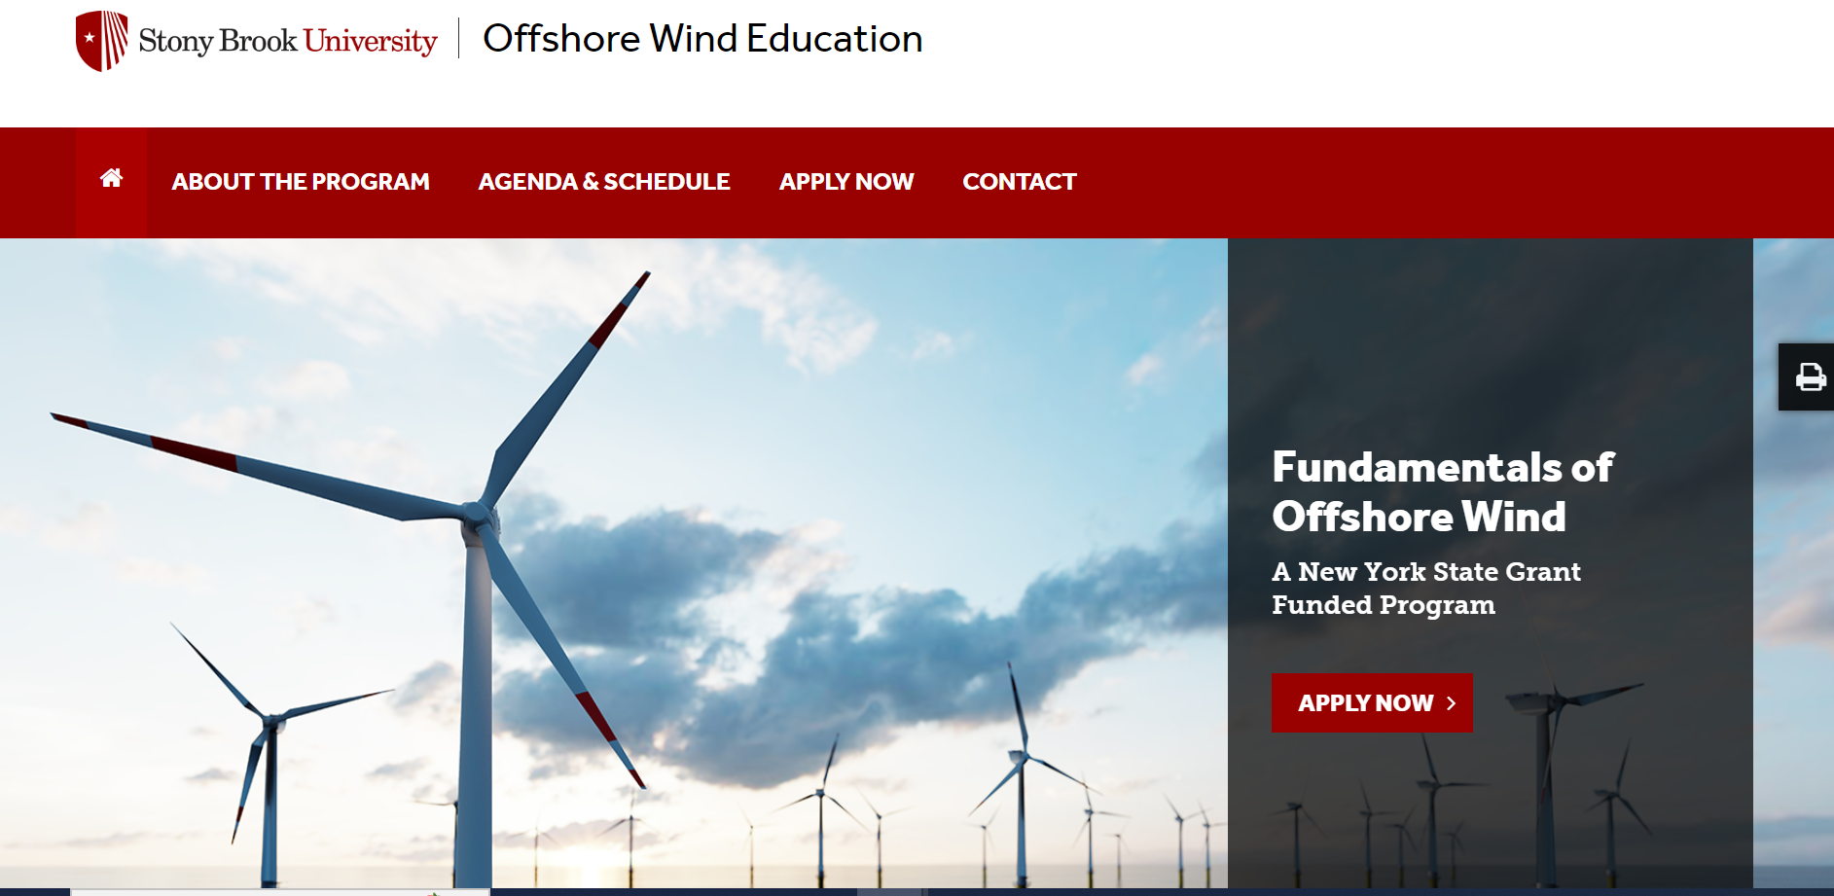

Slide 32
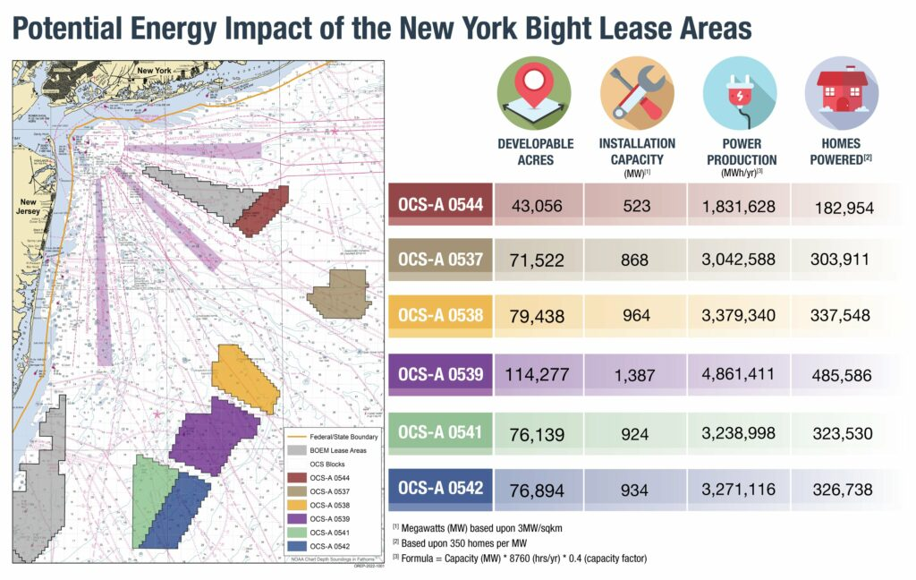
BOEM Lease Winners 2022
Lease Numbers | Winning Companies
OCS-A 0544 | Mid-Atlantic Offshore Wind LLC (partnership with Copenhagen Infrastructure Partners, and Invenergy Wind Offshore)
OCS-A 0537 | OW Ocean Winds East, LLC: (EDP Renewables and ENGIE)
OCS-A 0538 | Attentive Energy LLC (EBW North America and TotalEnergies)
OCS-A 0539 | Bight Wind Holdings, LLC (RWE Renewables and National Grid)
OCS-A 0541 | Atlantic Shores Offshore Wind Bight, LLC (Shell New Energies US and EDF Renewables)
OCS-A 0542 | Invenergy Wind Offshore LLC (Invenergy and energyRe)

Slide 33
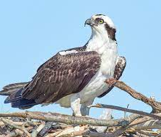
Offshore Wind: BIRDS
In 2014, the National Audubon Society conducted a study assessing climate change’s impacts to North America’s birds. The study found that 314 of 588 species would lose more than half their 2010 geographic range by 2080 due to climate change.
Among the most affected birds are the bald eagle, osprey, and piping plover. Additionally, sea level rise threatens sea turtle and shorebirds habitat.
Offshore wind mitigates the impacts of climate change!

Slide 34
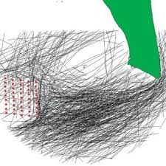
Offshore Wind & Wildlife BIRDS
The leading causes of bird deaths in America are habitat loss, tall buildings and cats.
Studies show that wind energy is one of the safest ways to produce energy with respect to bird impacts

Slide 35
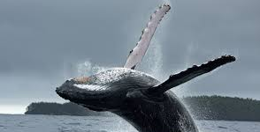
Offshore Wind & Wildlife WHALES
The NYS Department of Environmental Conservation (DEC) has documented several whale species, including humpback, fin, blue, and right whales, migrating off the coast of New York in the Atlantic Ocean

Slide 36
Offshore Wind: Protecting Whales
The construction agreement for the Block Island wind farm contained an important commitment by the wind developer to shut down construction operations if marine mammals were spotted in the vicinity.
In 2019, Vineyard Wind signed an agreement for an offshore wind farm, off the coast of Massachusetts, which curtailed construction during active migration of the endangered Right Whale, put limits on the speed of any vessels, and put rigorous monitoring measures in place to protect marine mammals.

Slide 37
It’s Not to Late too Act!
Every level of government must act to curb the worst impacts of climate change.
Local change matters!
Show Up!
Stand Up!
Speak Up!

